Slide 1
Kinematics and Dynamics of Robots
Spring Semester 2021
Lecturer: Yoav Golan

Slide 2
About the Lecturer
Yoav Golan
Research Interests: Robotic Grippers, Mobile Robot Navigation, Mechanism Design

Slide 3

Communication
Email address: yoavgo@post.bgu.ac.il
Moodle (Course site)
Office Hours (Zoom): TBD
WeChat :
wxid_jmcydelioqx122

Slide 4
Course Principles
Be open about your understanding
Creativity is good
You are encouraged to study together
Course is multidisciplinary and challenging, but practical

Slide 5
Course Etiquette
Referring to me- you can address me as “Yoav”, or however you prefer. Israeli education is very informal.
Asking questions during the lecture at any time is fine
You may also use office hours and/or email to ask further questions

Slide 6
Course Etiquette
The lectures will be recorded, and will appear in the course website
I will send messages to you via the course site. You will receive emails from the site.
If you think I made an error- with the course material or even pronouncing your name- please tell me.

Slide 7
Course Outline
12 lectures, 1 per week
Please reserve 16 weeks for the coursework
If a class is cancelled, another will be added at the end of the semester
Grade is individual, and based on 4 assignments

Slide 8
Course Outline
Syllabus is available in the course website
Weeks 1-6: Basics of robotics, kinematics and dynamics
Weeks 7-8: Path planning
Weeks 9-12: Practical robotic simulation

Slide 9
Assignments
Kinematics – a short math assignment. 10% of grade
Path planning – a programming assignment. 20% of grade
Robotic simulation – performing a simple task in a robotic simulator. The simulation will be performed by a real robot during a lecture. 10% of grade.

Slide 10
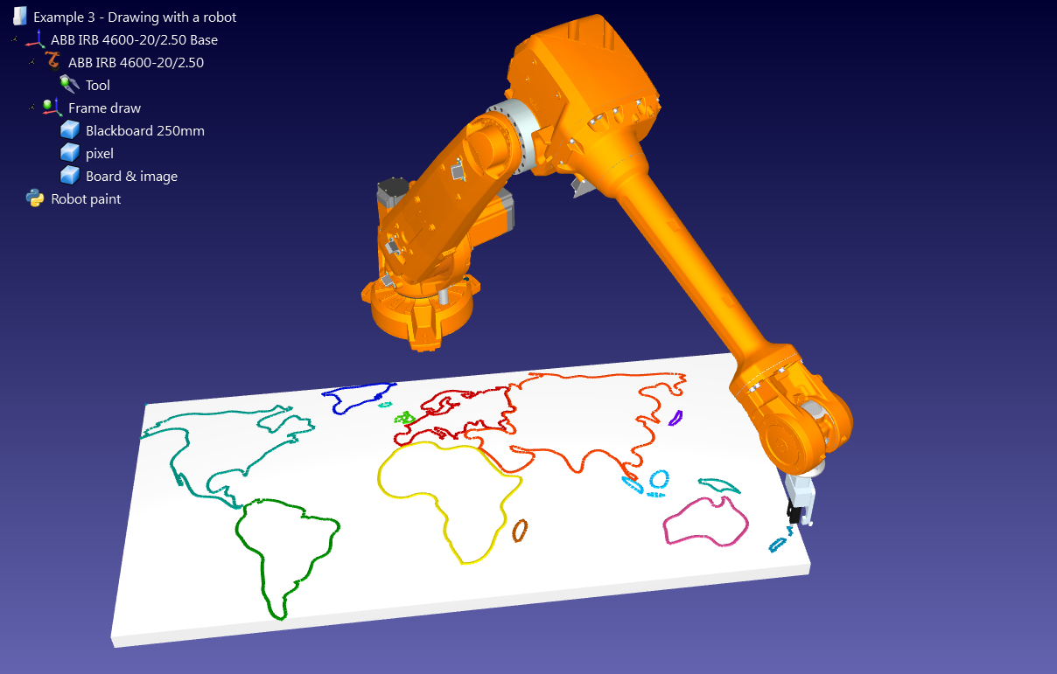
Assignments
Final assignment – creation of a complex manufacturing environment. 60% of grade.

Slide 11
What you need for the course
A compiler (any language), ~week 6
RoboDK robotics simulator, ~week 9
Literature: Relevant books and research articles will be referenced in the course website per lesson

Slide 12
Robotics in Industry Past, Present and Future

Slide 13
What is a Robot?
No one definition
Good consensus:
A programmable machine
Has inputs and outputs
Can make “decisions” autonomously
Performs tasks

Slide 14
Better Question: What tasks should robots do?
What humans can’t
What humans don’t want to
What humans do slowly/badly

Slide 15
What tasks should robots do?
What humans can’t
Extreme environments
Space
Heat/Cold
High/low pressure (ocean floor)
Superhuman needs
Strength
Speed
Precision

Slide 16
What tasks should robots do?
What humans don’t want to
Uncomfortable environments
Heat/Cold
Dark
Unventilated/dangerous chemicals
Boring tasks
Repetitive
Unchallenging
Mistakes happen after time
Injuries can occur

Slide 17
What tasks should robots do?
What humans do slowly/bad
Computers are great at some things, bad at others
Examples: Sorting, welding, painting, machining

Slide 18
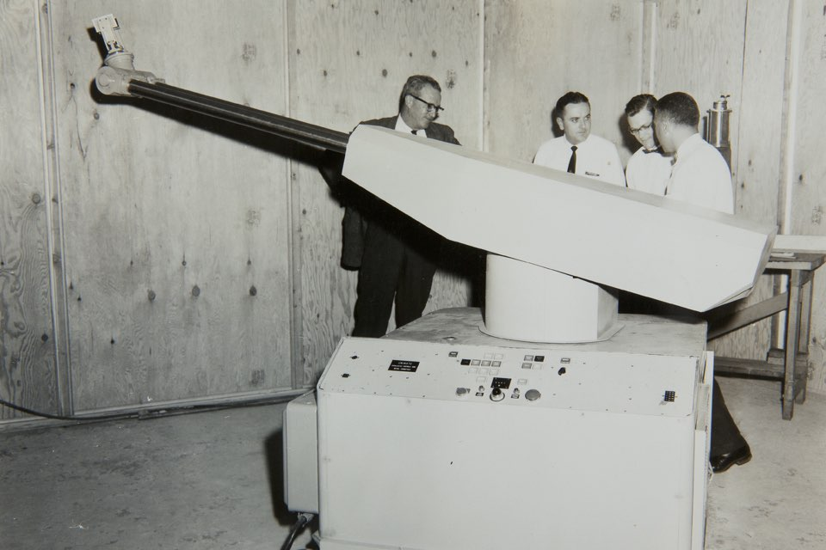
The First Industrial Robot
“UNIMATE”
Introduced in USA, 1962
Used for GM
Transports castings, welds
Toxic fumes involved

Slide 19
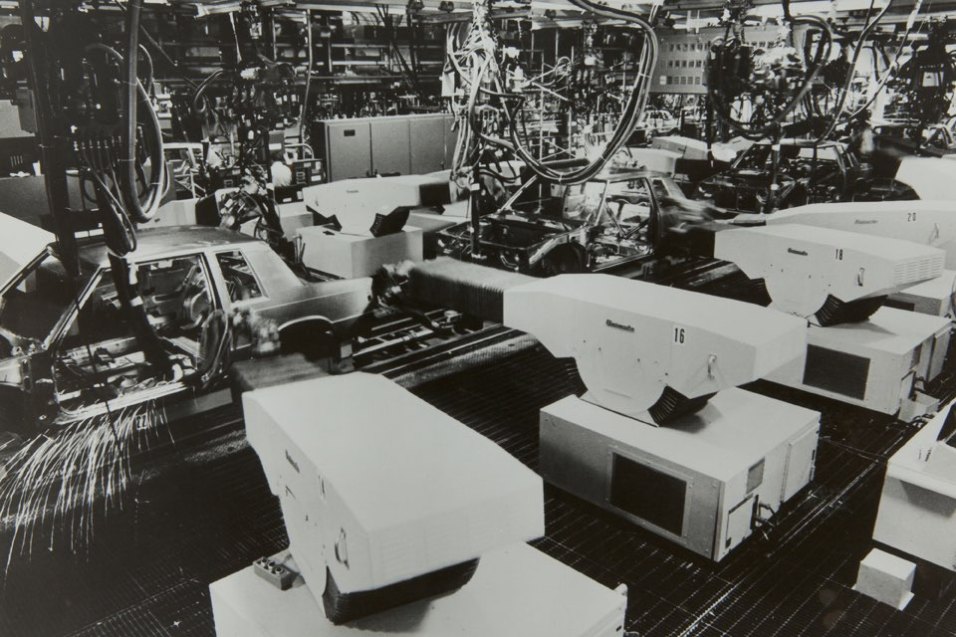
The First Industrial Robot
“UNIMATE”
Introduced in USA, 1962
Used for GM
Transports castings, welds
Toxic fumes involved

Slide 20
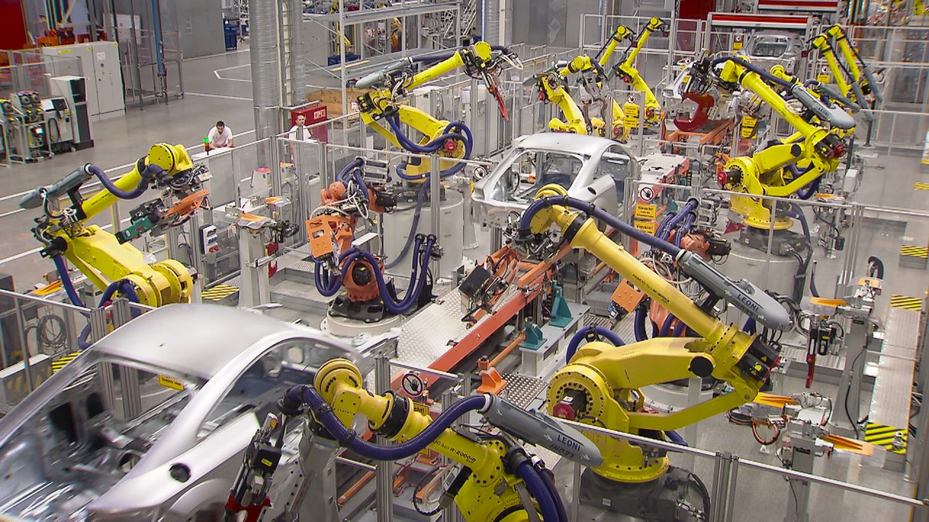
Today’s Industrial Robots

Slide 21
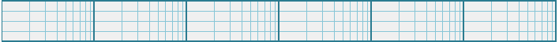
How many robots are working worldwide?
10³
10⁴
10⁵
10⁶
10⁷
10⁸
10⁹
Notes:
Answer: 2.7M

Slide 22
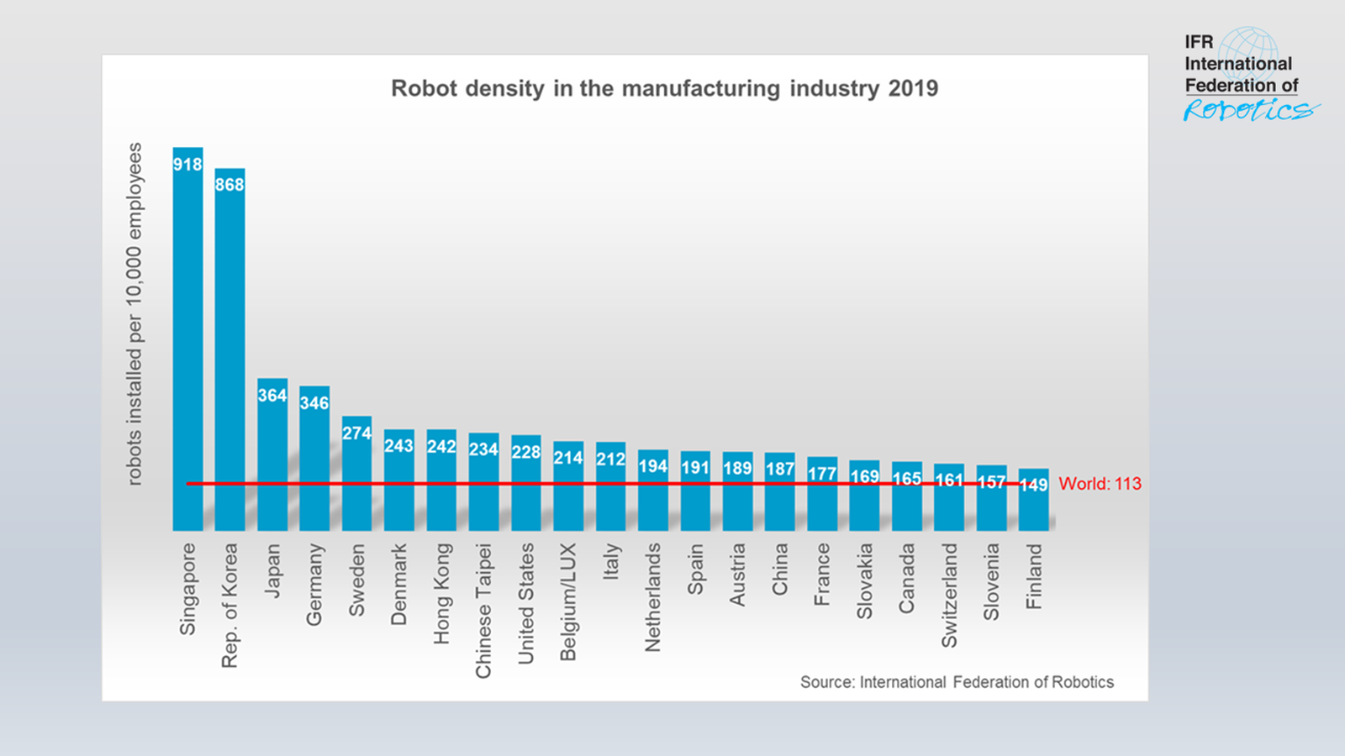
Most Recent Statistics

Slide 23
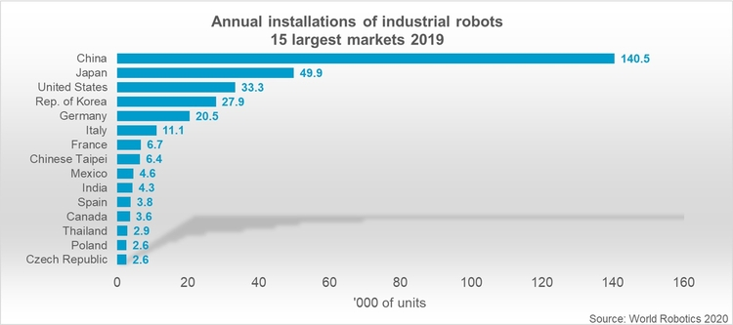
Most Recent Statistics

Slide 24
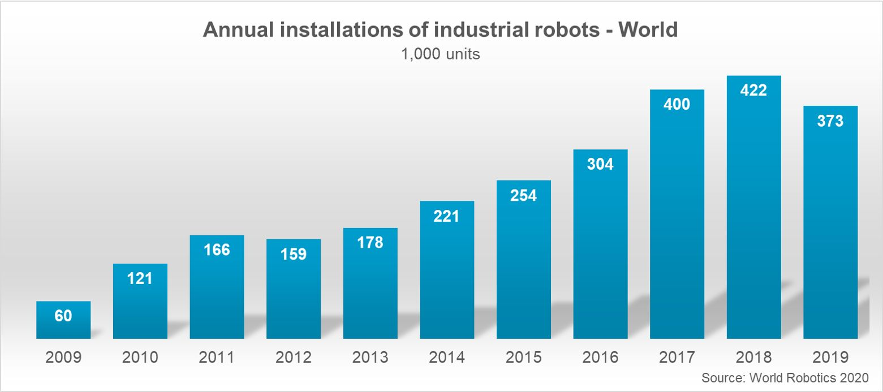
Most Recent Statistics

Slide 25
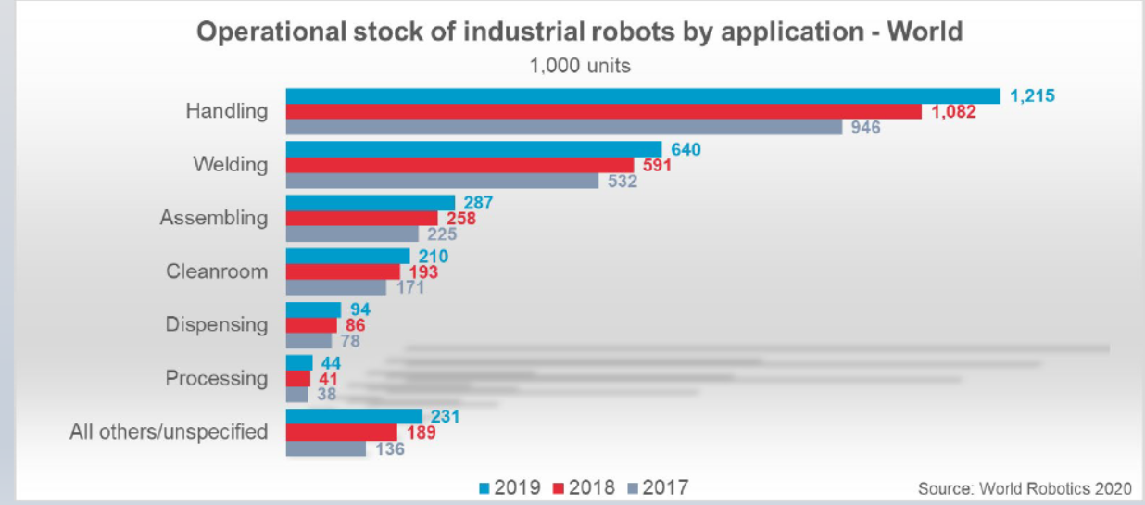
Most Recent Statistics

Slide 26
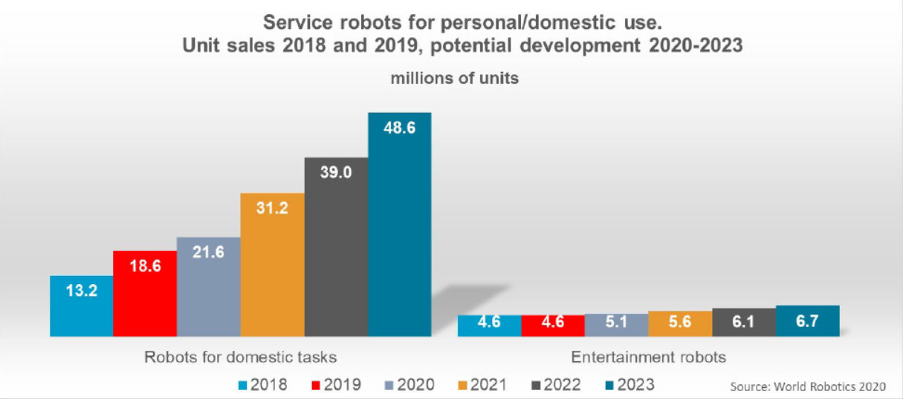
Most Recent Statistics
Domestic Robots

Slide 27
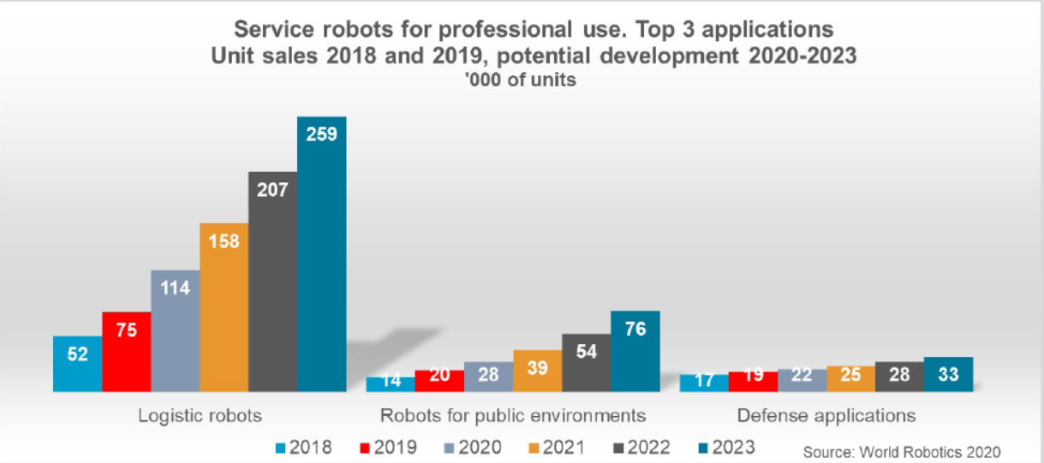
Most Recent Statistics
Professional Service Robots

Slide 28
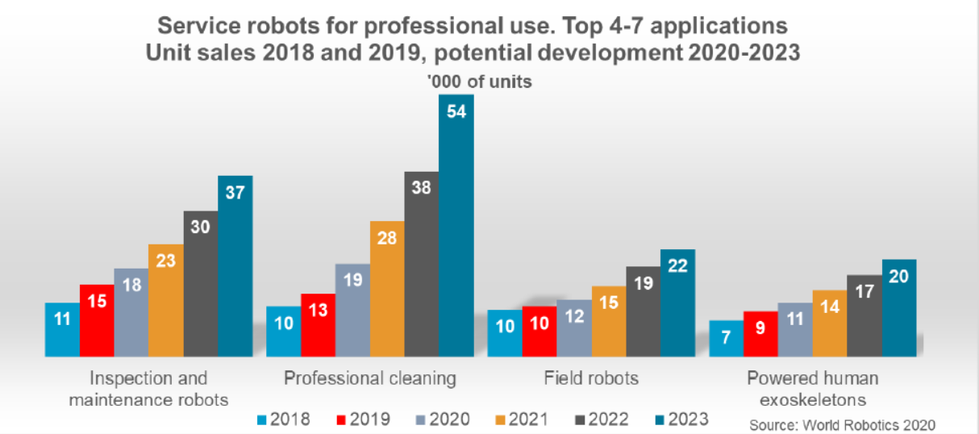
Most Recent Statistics
Professional Service Robots

Slide 29
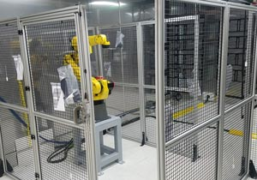
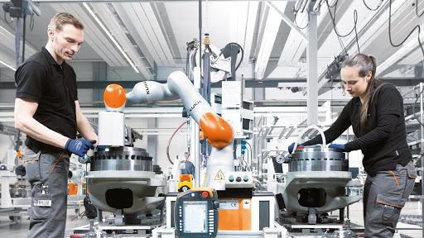
Newest trend: Cobots

Slide 30
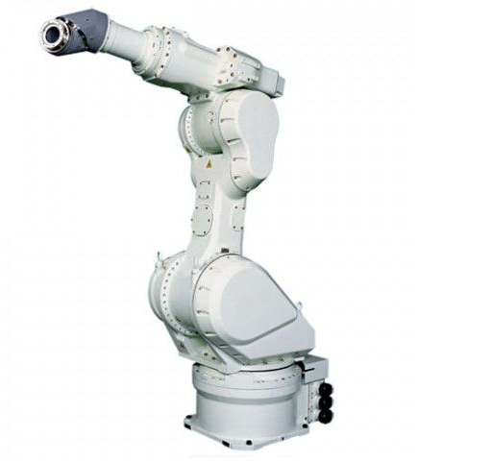
Types of Industrial Robots
Articulated
“Serial” robotic arms
Normally 4-7 axes
6 is the most common
Non-planar applications

Slide 31
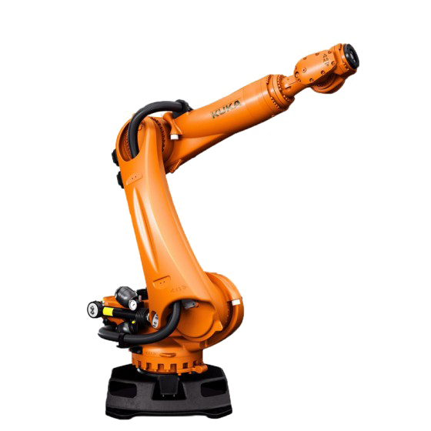
Types of Industrial Robots
Articulated Robot uses
Welding
Pick-and-Place
Assembly
Painting
Inspection
Material removal
Much more

Slide 32
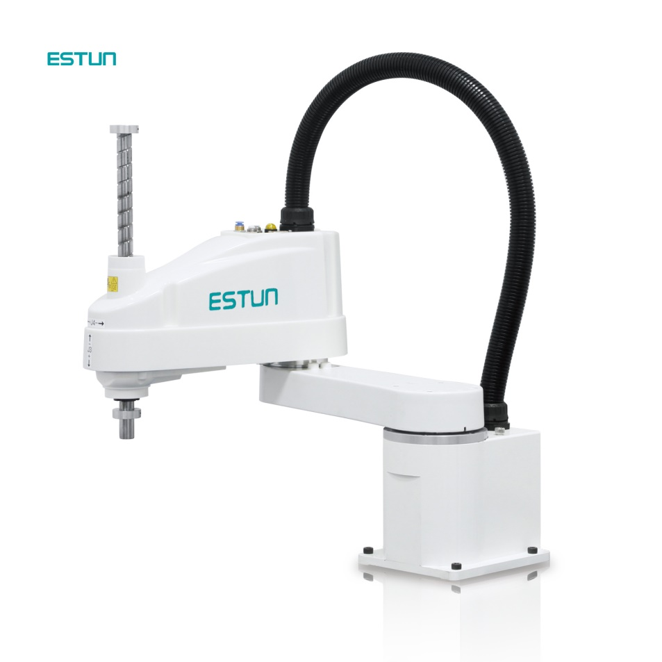
Types of Industrial Robots
SCARA
Selective Compliance
Articulated Robot Arm
Normally 4 axes or fewer
Parallel plane applications

Slide 33
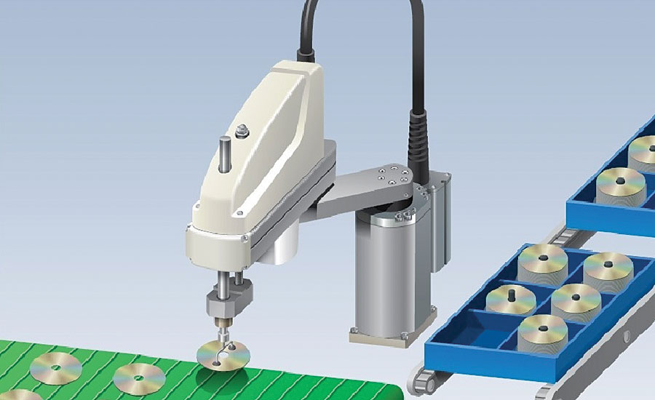
Types of Industrial Robots
SCARA uses
Pick-and-Place
Assembly
Packaging
Inspection

Slide 34
SCARA vs Articulated
Articulated robots can do almost everything SCARA robots can.
So why use SCARA?

Slide 35
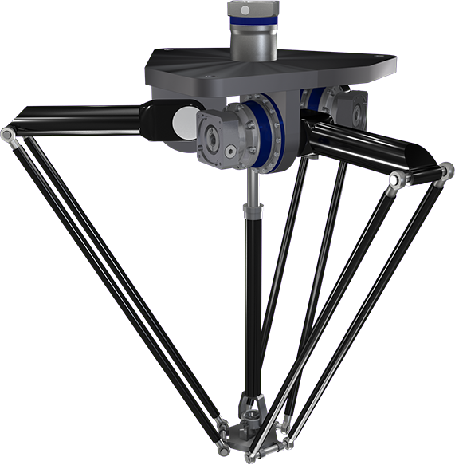
Types of Industrial Robots
Delta
“Parallel” robotic arm
Normally 3 axes, up to 6
Mostly planar applications
Incredibly fast

Slide 36
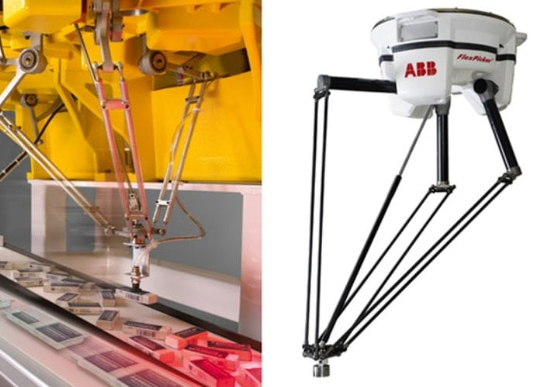
Types of Industrial Robots
Delta uses
Pick-and-Place
Assembly
Inspection

Slide 37
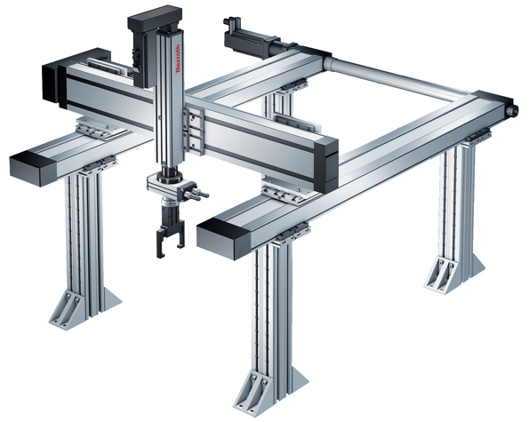
Types of Industrial Robots
Cartesian
Linear motors
Can be built very high

Slide 38
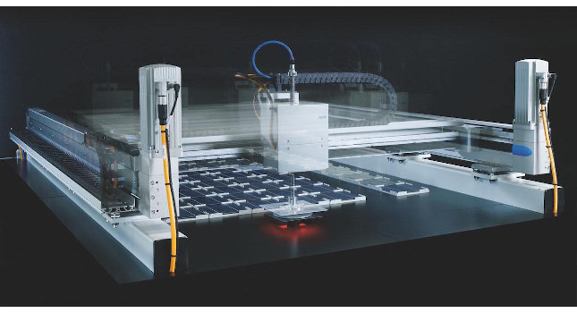
Types of Industrial Robots
Cartesian uses
Pick-and-Place
Assembly
Inspection
Dispensing

Slide 39
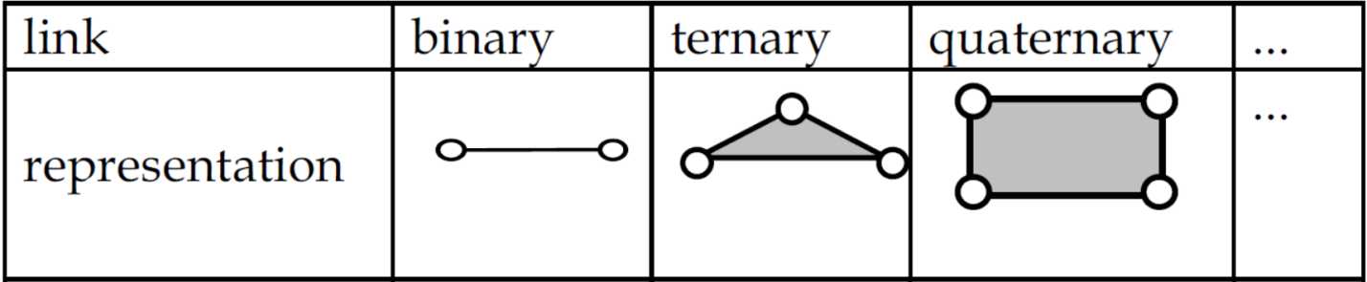
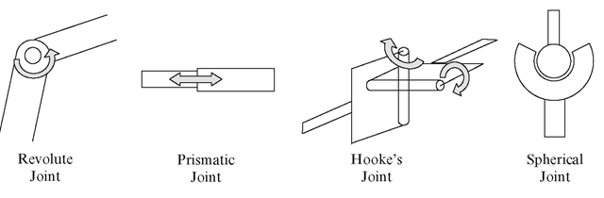
Kinematic systems
A kinematic system is made of links and joints

Slide 40
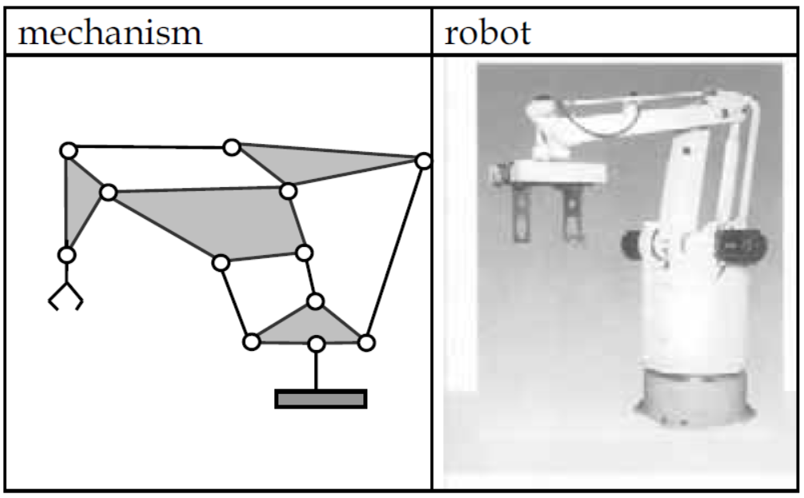
Kinematic systems
A kinematic system is made of links and joints

Slide 41
Degrees of freedom DOF
Definition: Number of independent aspects of motion
Chebychev–Grübler–Kutzbach criterion:
2D:
3D:
Number of moving bodies (including the ground)
Number of joints
The number of joints with i DOF

Slide 42
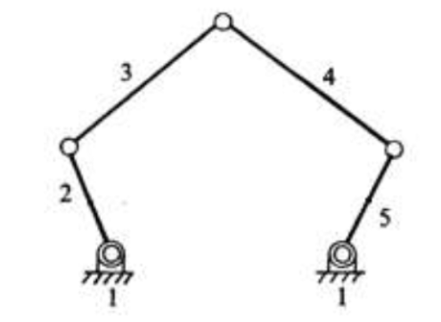
Degrees of freedom
Example:
5
5
5
0
Number of moving bodies (including the ground)
Number of joints
The number of joints with i DOF

Slide 43
Degrees of freedom
Example:
10
12
12
0
Number of moving bodies (including the ground)
Number of joints
The number of joints with i DOF

Slide 44
Degrees of freedom
Example:
Demonstration

Slide 45
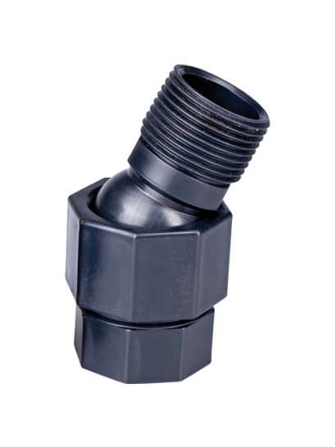
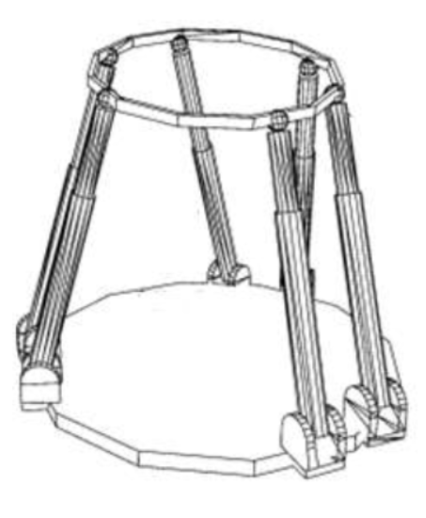
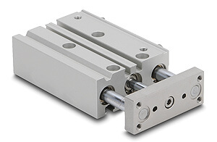
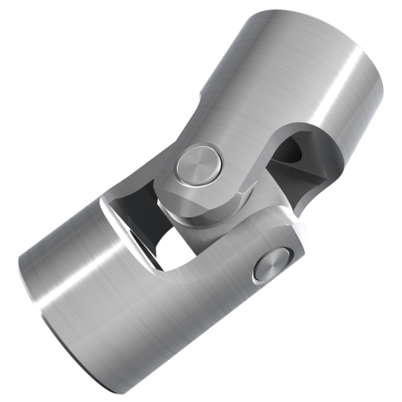
Degrees of freedom
Example:
i=3 DOF
i=1 DOF
i=2 DOF

Slide 46
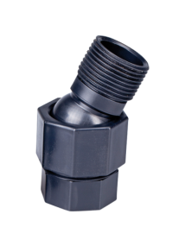
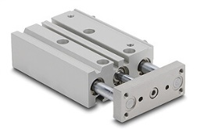
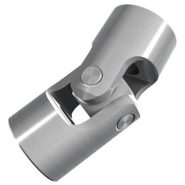
Degrees of freedom
Example:
i=3 DOF
i=1 DOF
i=2 DOF

Slide 47
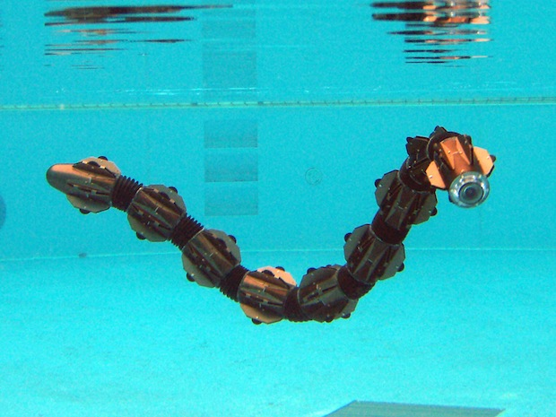
DOF in 3D?

Slide 48
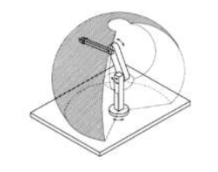
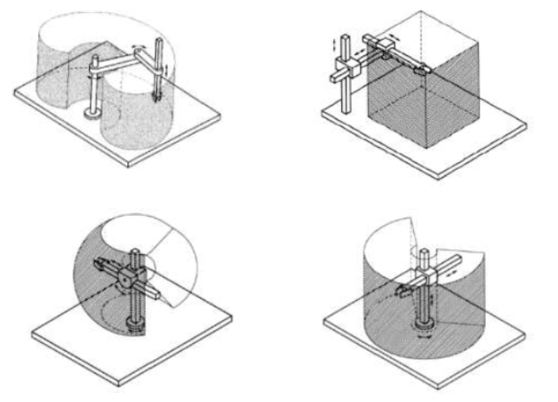
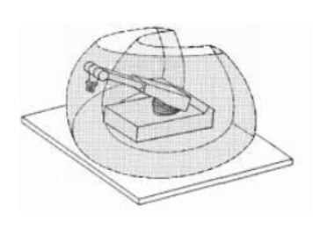
Robot Workspace

Slide 49
Workspace vs Dexterity Space

Slide 50
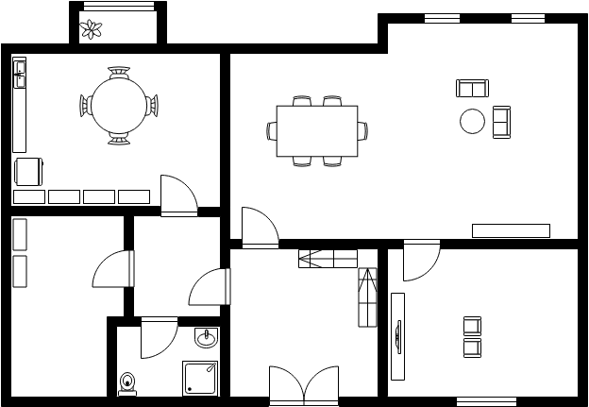
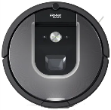
Where is the robot?

Slide 51
Reference Frames

Slide 52
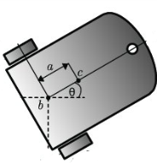
Reference Frames

Slide 53
Reference Frames
How do we describe one reference frame relative to another?
y2
x2
y1
P
x1

